Slide 1
Other Privacy & Security topics

Slide 2
Presentations
Individual Presentations

Slide 3
Other Privacy/security protections
Food, drug & Cosmetic act (FDA, 1938)
21st Century cures act (2016)
  Prevent information blocking
  Excludes 5 categories of software functions from FD&C –
    Admin support – scheduling
    General wellness – fitness, stress reduction
    PHR software
    Medical device data system software – transfer, store, convert formats (not analyzing)
    Clinical Decision Support

Slide 4
Other Privacy/security protections
21st Century cures act, Cont
  Information blocking exceptions
    Prevent harm, more stringent state/federal preconditions, inability to validate right of access, patient request
  Requires secure application programming interfaces
    Fast Healthcare Interoperability Resources (FHIR) API
    Standardization, encryption, authentication – mobile health app
U.S. Consolidated Appropriations Act (2022)
  Requires manufacturer cybersecurity plan

Slide 5
Telemedicine During Covid
Scope
The actual delivery of remote clinical services using technology to facilitate the exchange of medical information from one site to another
Telehealth services did not need to fully comply with HIPAA requirements
OCR did not impose penalties for noncompliance during the emergency
Any non-public facing remote communication product could be used for any diagnosis (not just Covid)
  Approved: FaceTime, Facebook Messenger video chat, Google Hangouts video, Zoom or Skype
  Not approved: Facebook live, Twitch, Tik Tok
Providers encouraged to notify patients of privacy risks and should enable all available encryption and privacy modes
Notes:
Allows for technology to monitor pt from a distance….cronic condition monitoring...from pts home to mds office. Beneficial for everyone around. More real time monitoring.
Admin- pt education (bc will be people with cronic conditions) on the use of technology, they should understnad the principles around using/ concept of telemedicine and that it’s an ongoing process. Want to make sure that data is encrypted in transit to md.
How do we know that the data receiving form these home machines are acurate? Have to test and make sure it’s working. Have to have periodic accurate checking. If there’s an update how will the update happen- remotely? Have to go to the house?

Slide 6
First Responders, Covid-19 and HIPAA
PHI of COVID-19 infected individuals could be released to law enforcement, paramedics, other first responders and public health authorities

Slide 7
community-based testing sites
On 4/9/20, OCR announced it would not impose penalties for violations of HIPAA rules against CEs or BAs in connection with good faith participation of COVID-19 testing sites

Slide 8
OCR guidance on restrictions on media access to PHI
On 5/5/20, the OCR issued guidance reminding providers HIPAA does not permit them to give media access to facilities where patients’ PHI is accessible without prior patient authorization
Must have valid authorization form from patient
Obscuring patient faces is not sufficient

Slide 9
OCR Guidance on contacting former covid patients about blood/plasma donations
On 6/12/20/, OCR issued guidance permitting CEs to identify and contact patients who have recovered from COVID for population based activities relating to improving health.
CEs may not receive payment for blood and plasma donation centers in exchange for such communications with patients

Slide 10
Cares act passed on 3/27/2020
Expanded the ability of providers to share substance abuse records
  One consent signed for all covered entities
Same breach notification requirements apply as all other breaches

Slide 11
December, 2022: On-Line Tracking Guidance
Individually identifiable health information collected on website/mobile app that needs user login is PHI
Unauthenticated websites in which users can enter health information to search for doctors or symptoms of disease also regulated
June 20, 2024 ruled unlawful, but could be changed

Slide 12
Other Protections
FTC
  Sep, 2021: Policy statement reaffirming breach notification rule (mobile app data)
  Feb, 2023: $200k fine issued to GoodRx
    Shared health information w/ Facebook / Google for advertising purposes (no consent)
Patient Device Data Bill (2024) - FDA oversight
  Would cover remotely monitored medical devices
  Manufacturers must disclose all data created and share w/ patients

Slide 13
Substance use confidentiality regulations
HHS Substance Abuse and Mental Health Services Administration in 2010
Apply to Part 2 Programs – Federally funded SUD programs
Require patient consent for disclosure including to other healthcare providers – 1 for all future TPO
  Exceptions: court order, non-identifiable
  Additional consent for physician notes
Breach notifications / penalties align with HIPAA

Slide 14
State privacy laws

Slide 15
Artificial Intelligence role in privacy

Slide 16
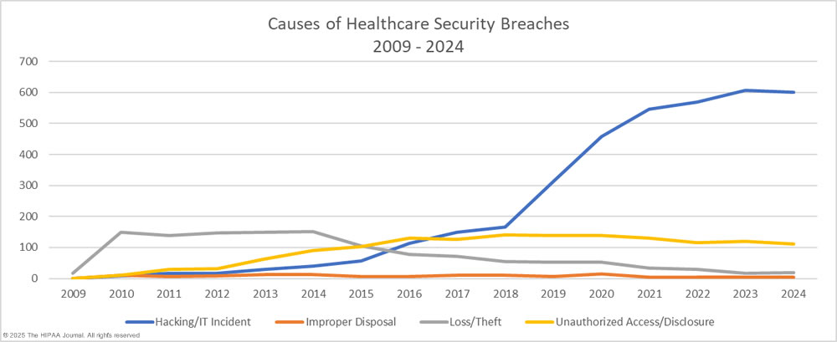
Other information
Source: HIPAAjournal.com (July 15, 2025)

Slide 17
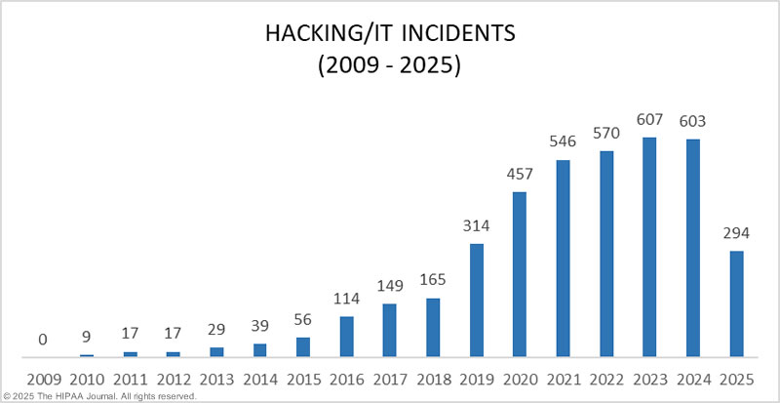
Other information
Source: HIPAAjournal.com (July 15, 2025)

Slide 18
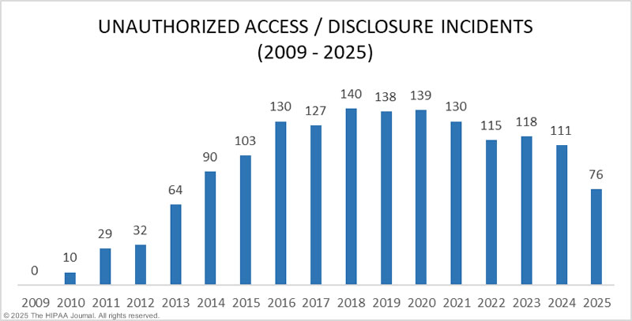
Other information
Source: HIPAAjournal.com (July 15, 2025)

Slide 19
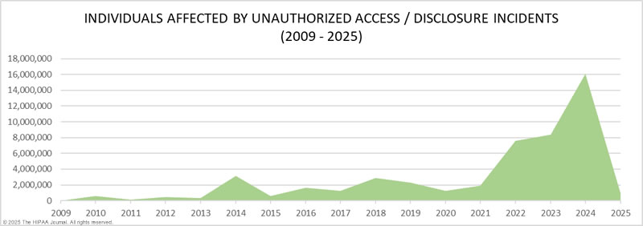
Other information
Source: HIPAAjournal.com (July 15, 2025)

Slide 20
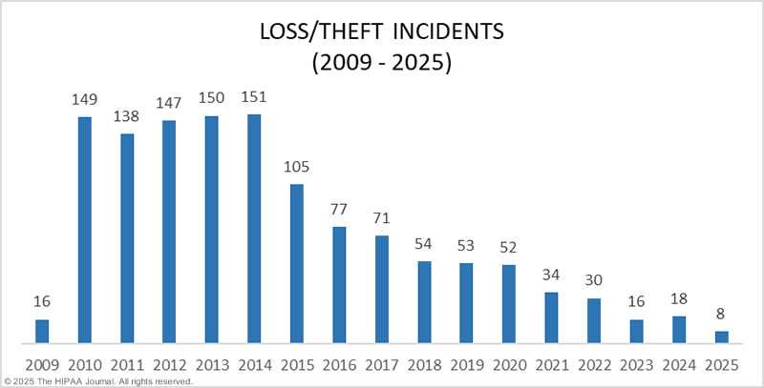
Other information
Source: HIPAAjournal.com (July 15, 2025)

Slide 21
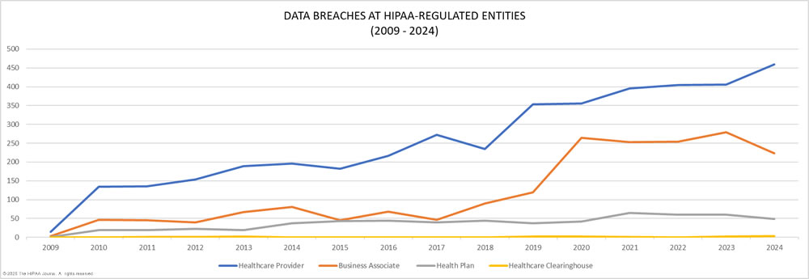
Other information
Source: HIPAAjournal.com (July 15, 2025)

